Slide 1
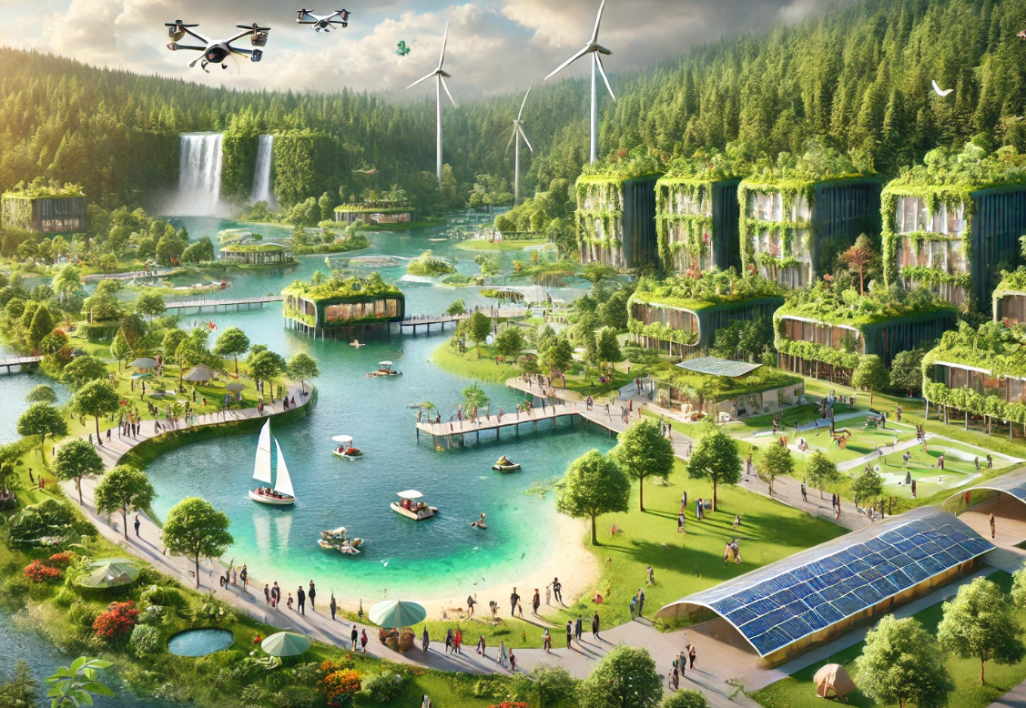
Ecosystem Restoration Corporation
Business as Unusual
Martin Ondra & Petr Dušek
13 December 2024 Design of Information Services Masaryk University

Slide 2
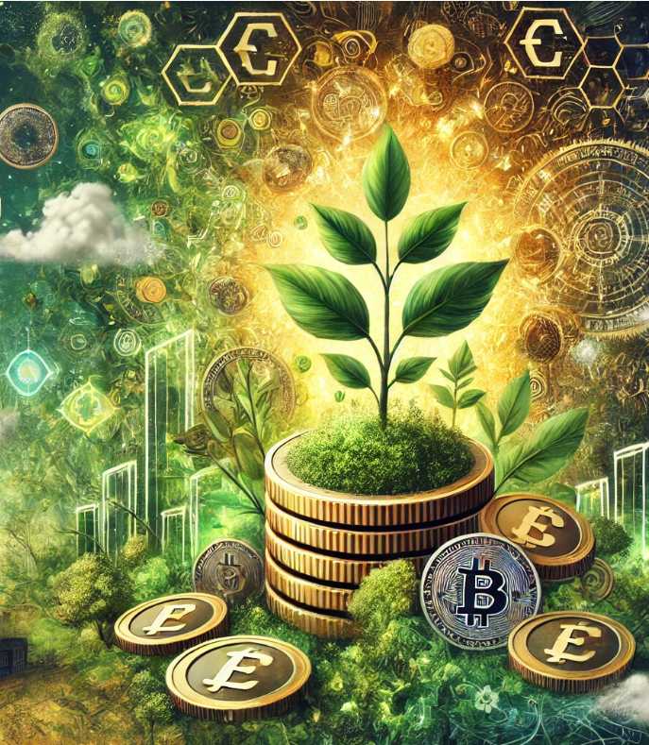
Similar Ideas
Carbon curency: Very similar idea, however, not very detailed. Carbon as currency for all (companies/individuals). For planting trees / sustainable behavior you get credits, states have tax incentives, company can use them a part of a salary.
Eco-coin: Earn coins for sustainable action and use them to pay for inspiring products/services.
Growing green money: Local currencies as a way how to be more local and sustainability oriented. The article claims that although the currencies help to develop local business, it is hard to prove they also support sustainability
Developing new institutions for environmental governance: By supporting local currencies, we support local and "cash-less trade". It encourages volunteering. It helps to re-shape current consumption patterns.
Resource control by a sustainability based currency equivalent: Ecopoints - very similar idea. A final number of ecopoints is allocated on yerly bases to the whole planet. Trade with these points is allowed. Ecopoints are required for fresh resource extraction but not for recycled / reused materials, incentivizing circular economy practices. Prices of goods and services reflect their resource impact, promoting sustainable consumption and technological innovation.
Etc.

Slide 3
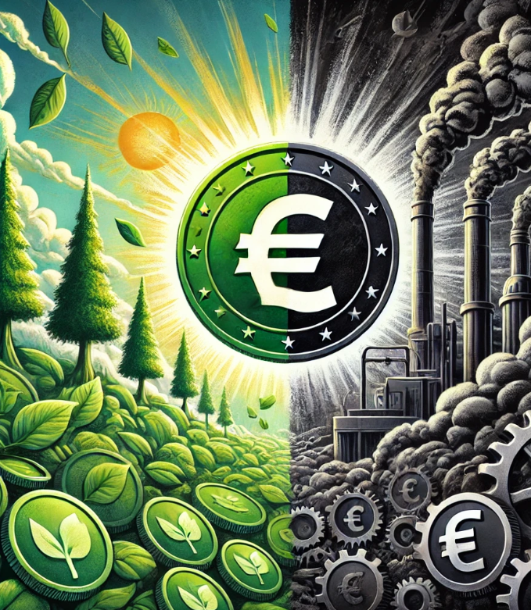
Ecosystem Restoration Model Basics
Parallel Alternative Currency
1. All product and services cost both money and Treecoin
2. Subjects can gain Treecoin by participating in environmental related projects or by purchasing environmentally friendly technologies or energy
3. Treecoin can be purchased from a state agency for money*
4. Gains from purchasing treecoin are used to fund environmental related projects, technology and research
5. Treecoin tracking relies on blockchain technology
How is Treecoin cost of product or services calculated?
On bases how much CO2e was calculated during service/product production (at the point of sale)
Companies would be required to measure their "carbon" footprint (based on GHG protocol)
There will be official recalculation industry average for products or services
How is Treecoin valuated?
It is pegged to monetary currency
Every country has its own sustainability-oriented coin
*Payment of Treecoin value can be done by a consumer in money, it is, however, treated as a purchase of Treecoin (via State Agency), which is then used for payment

Slide 4
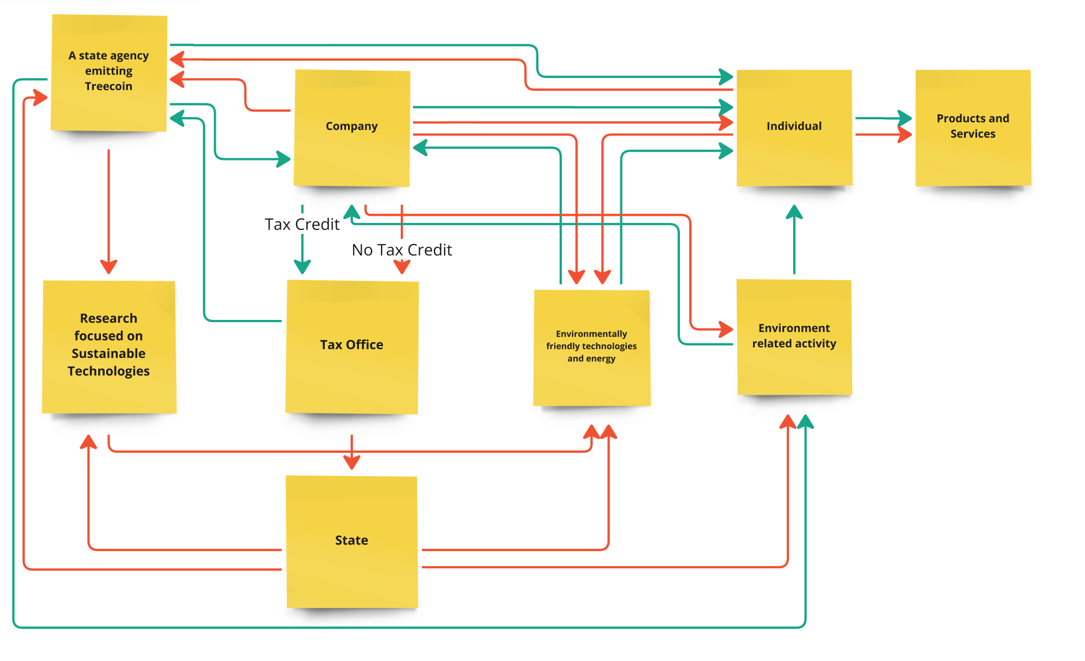
System Functioning
Money
Treecoin

Slide 5
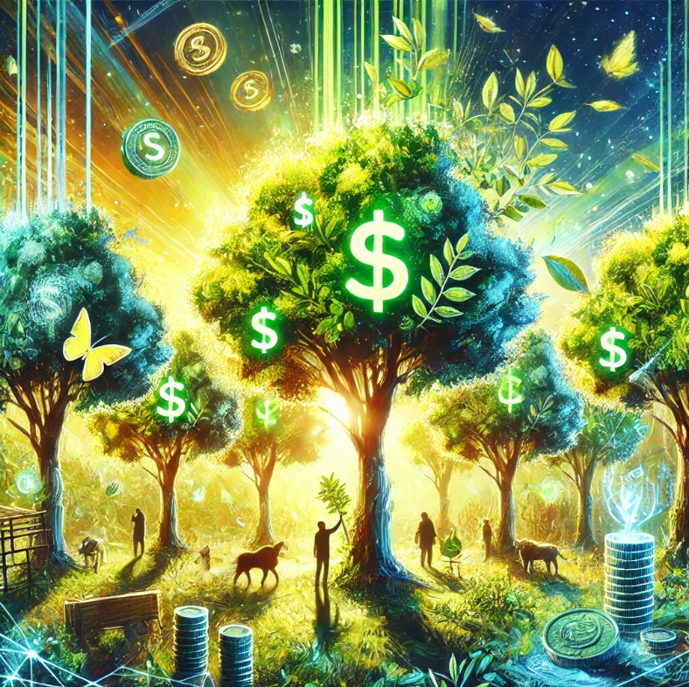
Gaining Treecoin: Threes Have Value
John is shopping
In an app he reserves a spot for planting a tree
On a bill he sees that 40% of the cost is in Treecoin
In a Garden Centre apps helps him to choose a tree with the biggest carbon capture potential (immediately and in a few years horizon)
This irritates him and he thus seeks ways how to gain Treecoin
After proving he planted the tree he is awarded Treecoin.
He finds out that there is an option to plant trees and have them as Treecoin investment
He is regularly awarded Treecoin for the rest of the three's life

Slide 6
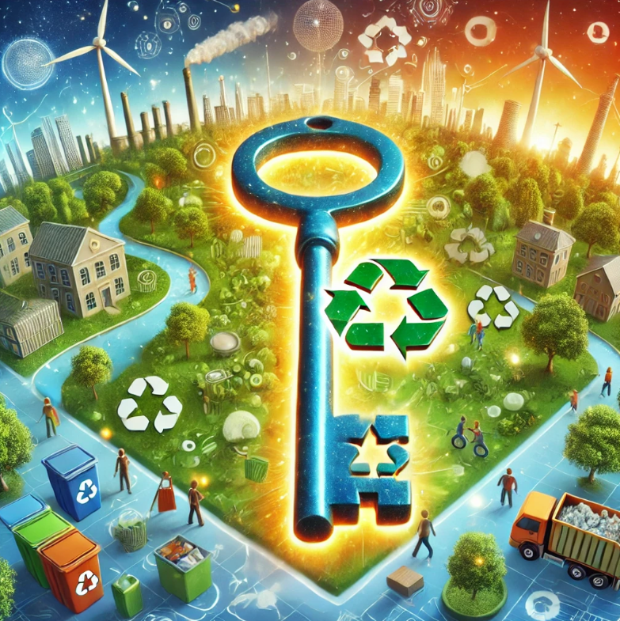
Gaining Treecoin: Recycling is Key
Marta cooks often and produces a lot of Biowaste
Biowaste is used for energy production
She sorts it out and once enough biowaste is accumulate, she goes to a Sorting Centre
There is less communal waste
At the centre it is checked that the biowaste was separated correctly
Remains are used to produce new soil
Marta gets Treecoin

Slide 7
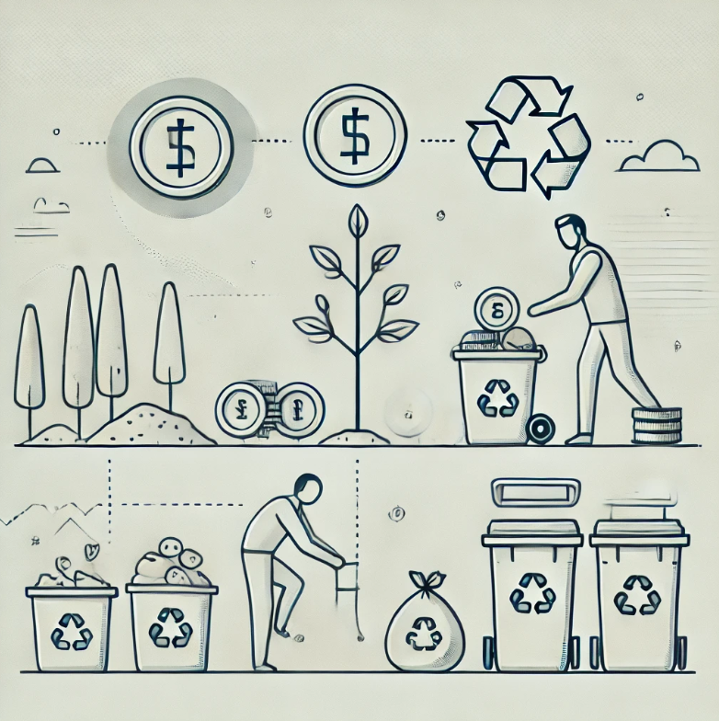
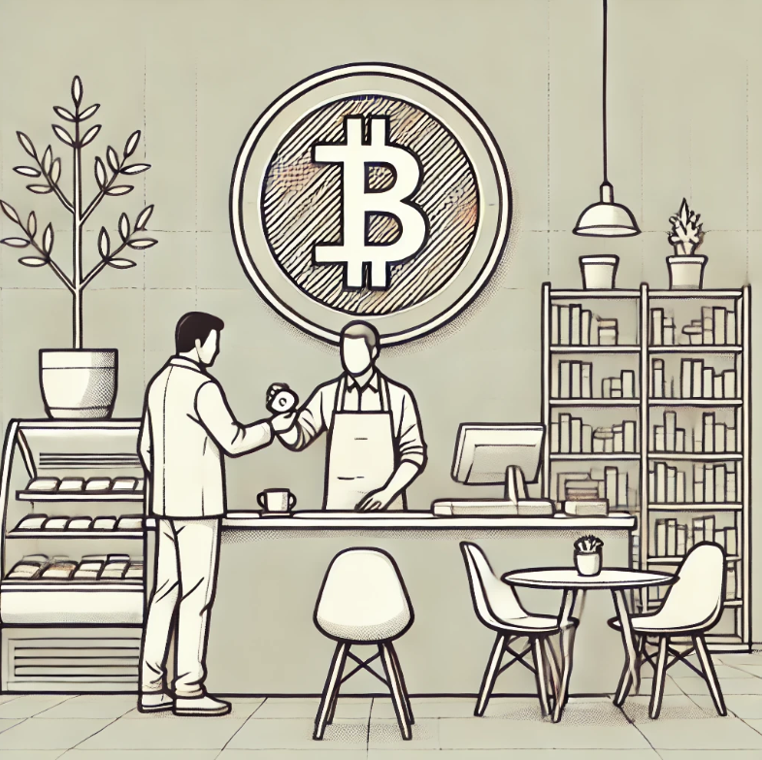
Simplified Pilot Project
Connecting Both Projects
Treecoin Circulation:
Environmental activities → earning Treecoin.
Treecoin → spending it in the café.
Pilot Testing:
Testing the system in practice at a local level.
Evaluating the effectiveness and feasibility of the concept.
1. Earning Currency – Tree Planting and Waste Sorting Principle of Earning Treecoin:
Tree Planting: Individuals, schools, or companies earn Treecoin for planting trees according to set standards.
Waste Sorting: Treecoin is awarded for regular and verified waste sorting.
Verification: A simple proof system, such as photographs, QR codes, or confirmation during waste collection.
Goal: To motivate individuals and companies to engage in environmental activities through rewards in the form of Treecoin.
2. Using Currency – Café with Library
Treecoin Usage:
The café accepts Treecoin as partial payment.
For example: 10 Treecoin = a free coffee or access to library services.
Community Connection: The local café serves as a hub for environmental education and knowledge sharing.
Goal: To demonstrate how Treecoin can be used in daily life and create motivation to participate in the system.

Slide 8
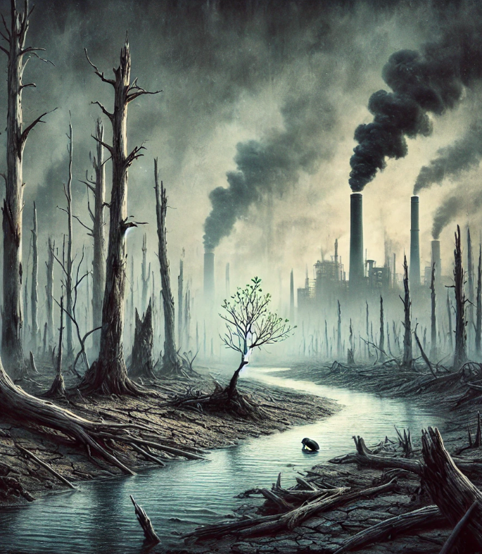
Why this Model?
Environmental Crises is one of the leading challenges of our time.
An alternative currency embroidered into everyday life raises awareness and shows real cost of products and services.
With Ecosystem Restoration Model we will:
Focus society on sustainability
Show the real cost behind products and services
Finance and promote environmentally focused research, technology, energy and projects
Support local producers
Disadvantage long supply chains

Slide 9
Thank you! Q&A?
By Martin & Petr

